Slide 1
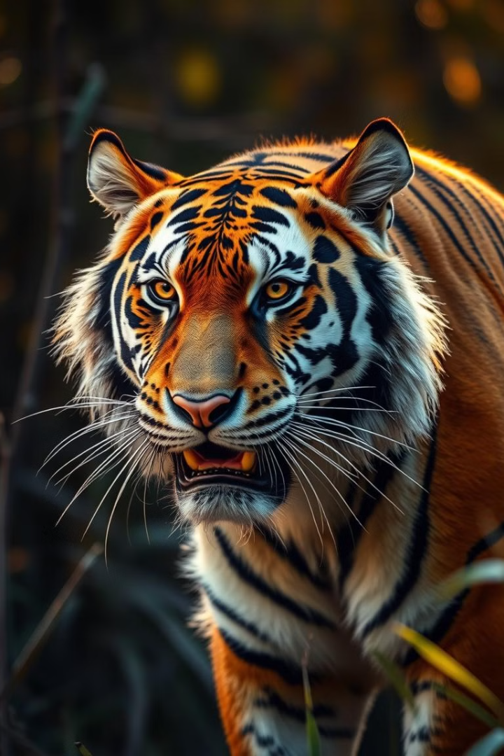




Protecting Endangered Species
Visvajeet R S
Aishwarya R
Arisha Begam T
Makilini

Slide 2
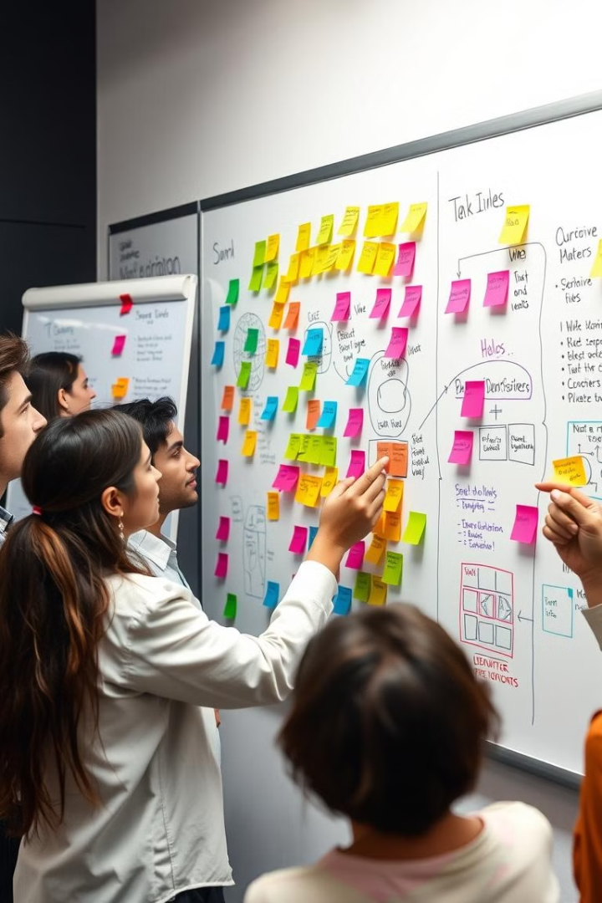
Brain Storming
1
Identify Threats
2
Explore Solutions
Brainstorm the key threats facing endangered species, such as deforestation, overhunting, pollution, and climate change.
Generate ideas for effective conservation strategies, including habitat restoration, anti-poaching measures, sustainable resource management, and public awareness campaigns.
3
Collaborate
4
Prioritize
Encourage cross-functional teamwork and engage with stakeholders, including policymakers, NGOs, and local communities, to develop a comprehensive action
Analyze the potential impact and feasibility of different ideas, and prioritize the most effective and impactful solutions.

Slide 3
Brain Storming
Habitat Loss
Climate Change
Poaching
Illegal Trade
Pollution
Invasive Species
Biodiversity Loss
Human Impact
Protected Areas
Captive Breedings
Reforestation
Habitat Restoration
Anti-Poaching Initiatives
Conservation
Deforestation
Biodiversity

Slide 4
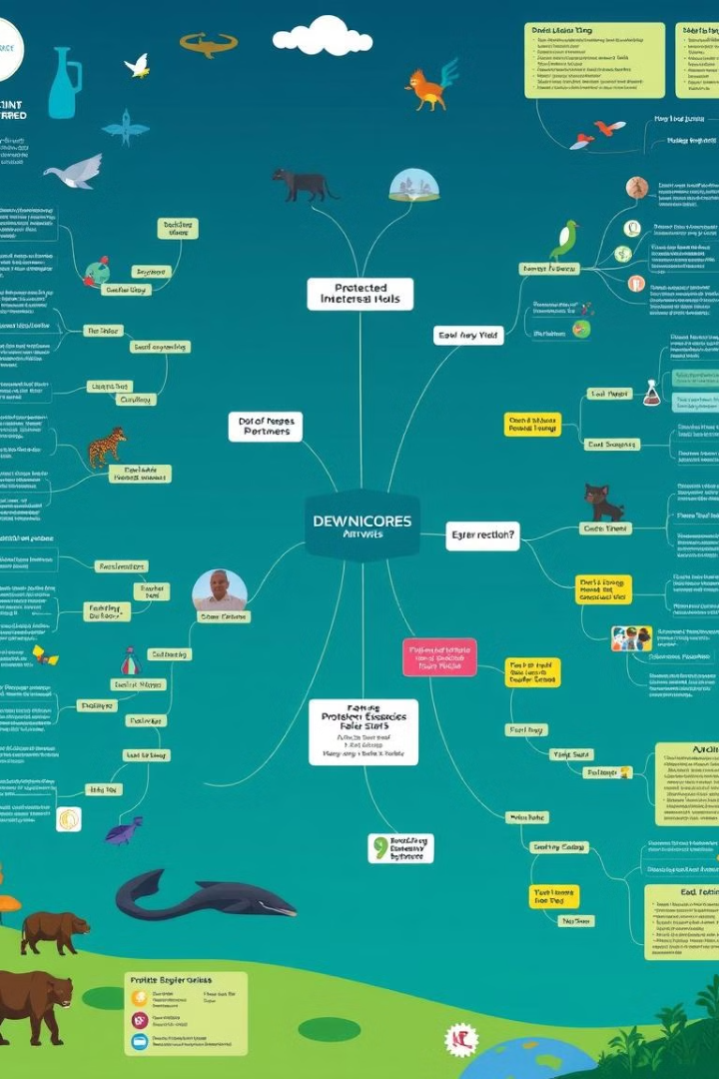
Mind Mapping
1
Identify Key Factors
Deforestation
Urbanization
Agricultural expansion
2
Climate Change
Rising temperatures
Melting ice caps
Changing rainfall patterns
Poaching and Hunting
3
Illegal wildlife trade
Trophy hunting

Slide 5
5Ws + 1H
Who
What
When
Governments: Create and enforce policies.
NGOs: Drive conservation efforts and awareness campaigns.
Scientists: Study and develop innovative solutions.
Clearly define the objectives and goals of endangered species conservation, such as preventing extinction, restoring habitats, and promoting sustainable practices.
When should action be taken?
Immediately. Delayed action could result in the extinction of more species and irreversible ecosystem damage.
Notes:
5

Slide 6
5Ws + 1H
Where
Why
How
Where are the critical areas?
Biodiversity hotspots (e.g., Amazon Rainforest, Coral Reefs, African Savannahs).
Protected areas like wildlife sanctuaries and national parks.
Regions affected by climate change or deforestation.
Why Biodiversity is essential for ecological balance and human survival?
Why Endangered species contribute to ecosystem services like pollination, seed dispersal, and maintaining food chains?
How can endangered species be protected?
Conservation: Create protected areas and captive breeding programs.
Awareness: Educate people through campaigns, schools, and social media.
Notes:
6

Slide 7
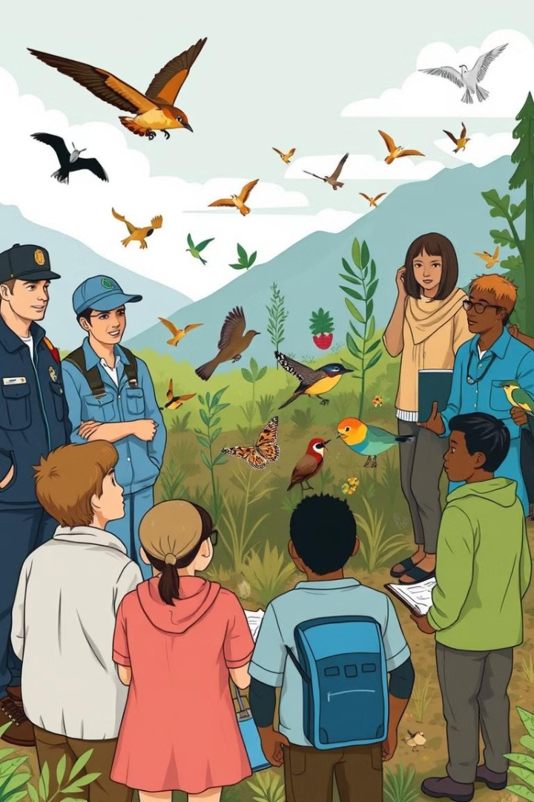




User Participant Mapping
Government Agencies
Scientists and Researchers
Policymakers, regulators, and enforcement authorities who can implement laws and regulations to protect endangered species.
Experts who study endangered species, their habitats, and the factors contributing to their decline.
Local Communities
Educators and Advocates
Individuals and groups who live in close proximity to endangered species and can play a role in conservation efforts.
Professionals who raise awareness, provide education, and engage the public in protecting endangered species.

Slide 8
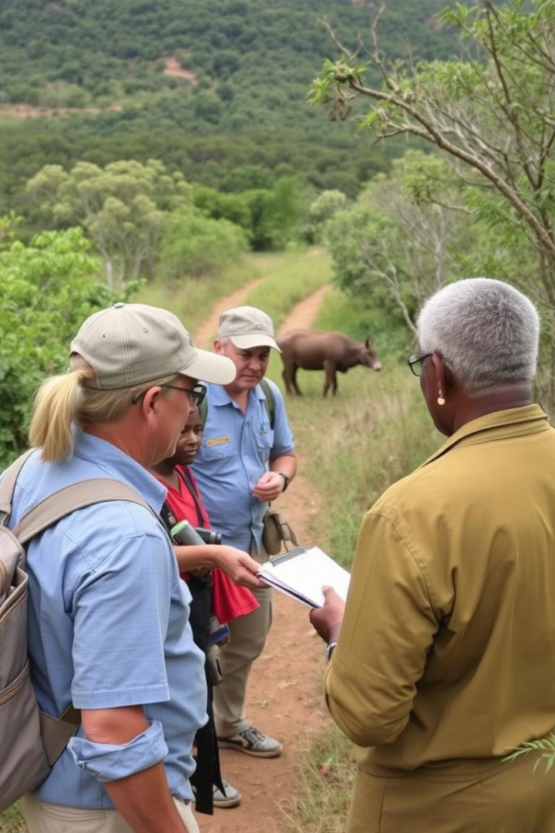
Contextual Inquiry
Observe Behaviors
Understand Challenges
Engage in hunting, farming, or fishing for livelihood, sometimes encroaching on natural habitats.
Use traditional knowledge that could contribute to conservation efforts if properly integrated.
Dependence on natural resources often conflicts with conservation goals.
Resistance to change due to lack of viable alternatives or education
Identify Opportunities
Collaborative Solutions
Implement AI-powered monitoring systems to detect poaching or track species migrations.
Develop mobile apps for public awareness, connecting people to local conservation projects
Provide sustainable livelihoods (e.g., eco-tourism, handicrafts) to reduce dependency on harmful practices.
Train communities to participate in conservation and monitor local wildlife.

Slide 9
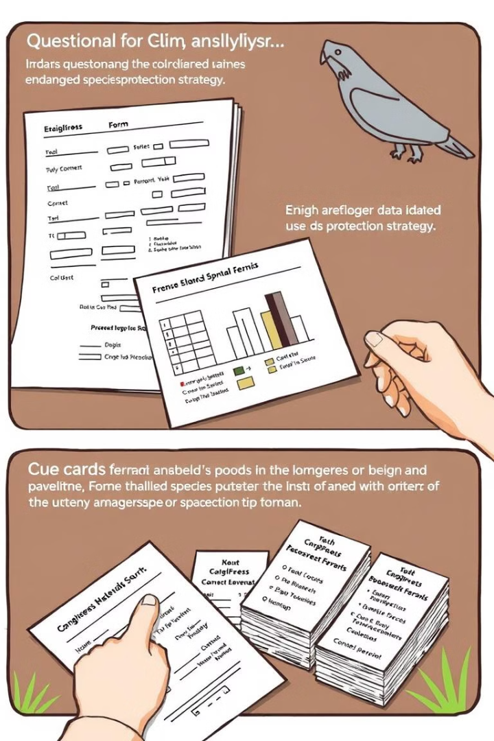



Questionnaires and Cue Cards
Awareness
How familiar are you with the term "endangered species"?
(a) Very familiar
(b) Somewhat familiar
(c) Not familiar
Knowledge
Which of the following do you believe are the biggest threats to endangered species?
(a) Habitat loss
(b) Poaching
(c) Pollution
(d) Climate change
Create Cue Cards
How do local communities interact with wildlife and ecosystems?
What motivates tourists, government officials, and NGOs in conservation?

Slide 10
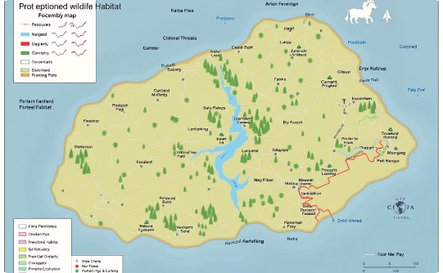
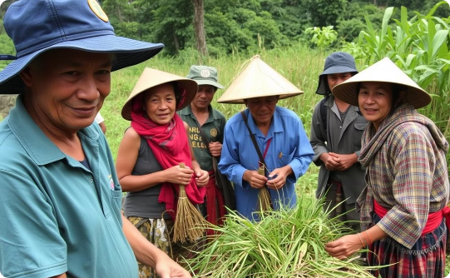
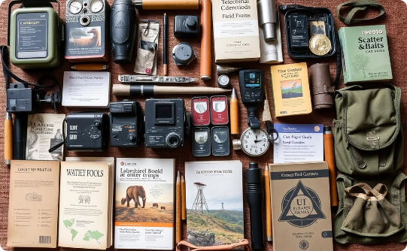
Artifact, Activity, and Spatial Mappings
Spatial Mapping
Artifact Mapping
Cameras and Drones:
Used for monitoring wildlife populations, tracking movements, and identifying threats like poaching.
Satellite Tracking Collars:
Attached to endangered animals for real-time tracking, migration pattern analysis, and health monitoring..
Activity Mapping
Catalog the various tools, technologies, and resources used by different stakeholders in endangered species protection, exploring how they can be better integrated and optimized.
Field Research and Monitoring:
Scientists and conservationists regularly conduct fieldwork to observe species in their natural habitats, recording population data, health indicators, and threats.

Slide 11
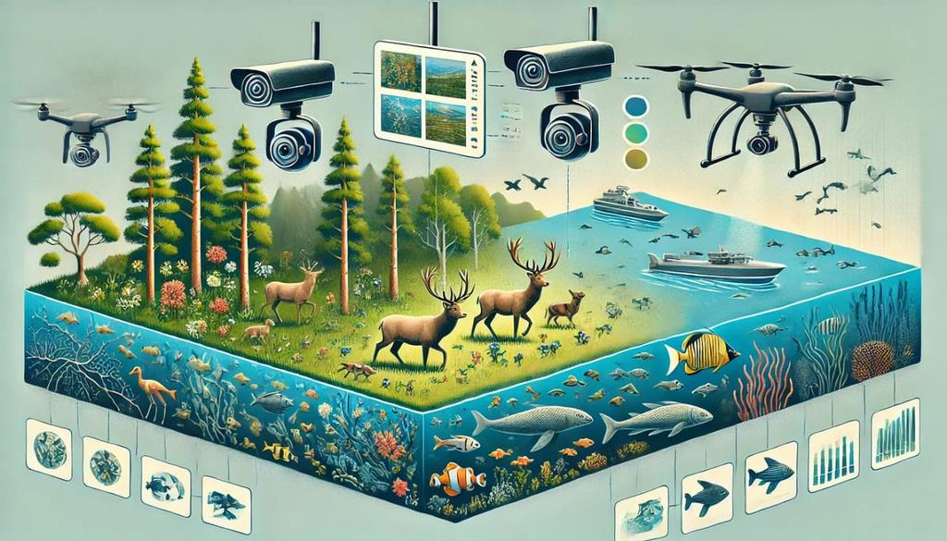
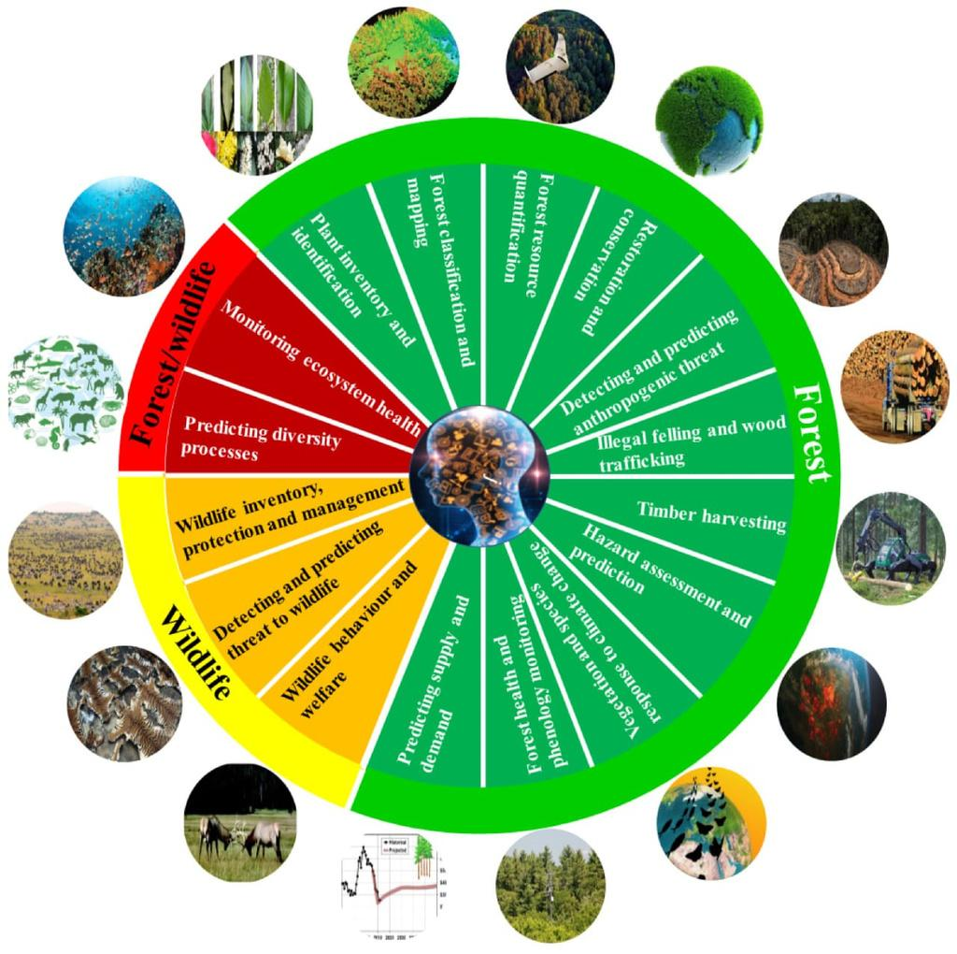
PROJECT MAPPING
->Identify endangered species in specific regions
Using AI
->Monitor populations through data collection
and analysis.
->Predict threats to species using machine
learning models.
->Educate the public about endangered species and
conservation efforts.

Slide 12
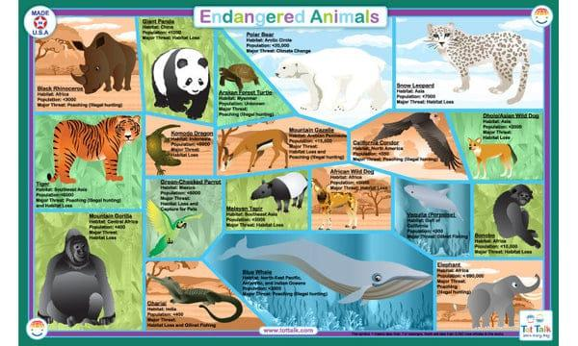

Sources: Gather data from wildlife databases, ecological studies, and satellite imagery.
Image Recognition: Use computer vision to identify species in images from camera traps or drones.
Predictive Analytics: Develop models to predict population trends and threats based on historical data.
Natural Language Processing: Analyze social media and news articles to track public sentiment and awareness.

Slide 13
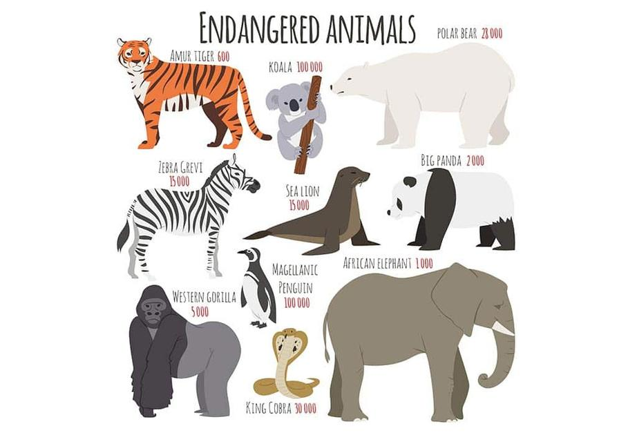
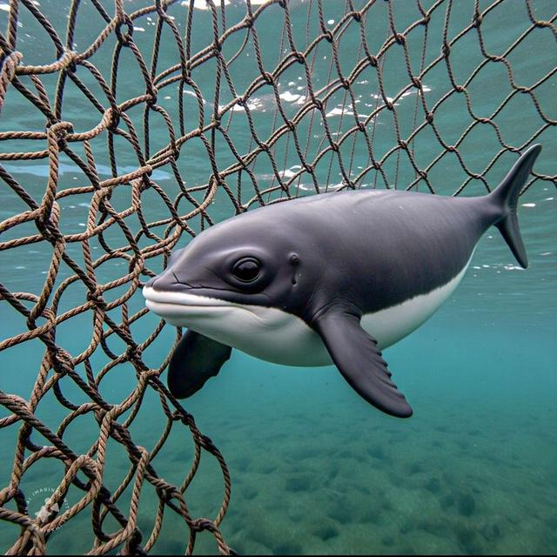
PERSONA’S
Conservation Scientist
Name: Dr. Emily Carter
Age: 38
Occupation: Ecologist
Background: Holds a Ph.D. in Environmental Science; specializes in wildlife conservation.
Goals: Conduct research on endangered species; publish findings; influence conservation policy.
Motivations: Passion for biodiversity; desire to protect ecosystems for future generations.
Challenges: Limited funding for research; difficulty accessing data.
The Local Community Member
Name: Carlos Rodriguez
Age: 45
Occupation: Farmer
Background: Lives near a protected area; has traditional ecological knowledge.
Goals: Sustainable farming practices; community well-being; preserve local wildlife.
Motivations: Concern for the environment; interest in preserving family land; community health.
Challenges: Economic pressures; potential conflicts with conservation regulations.

Slide 14
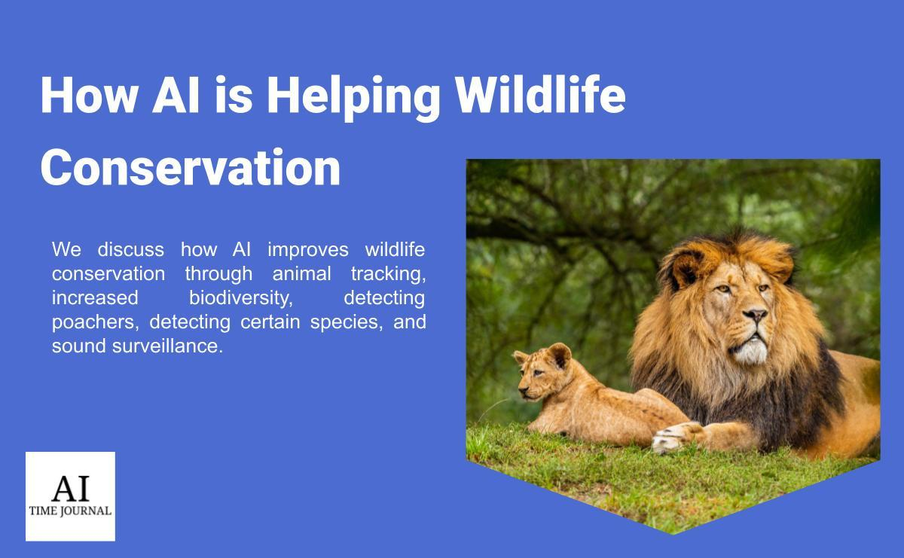
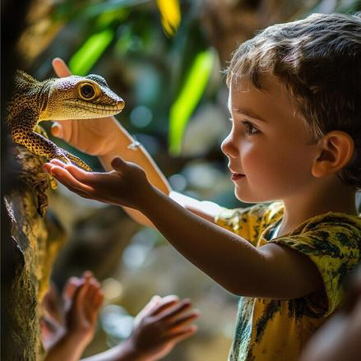

Slide 15
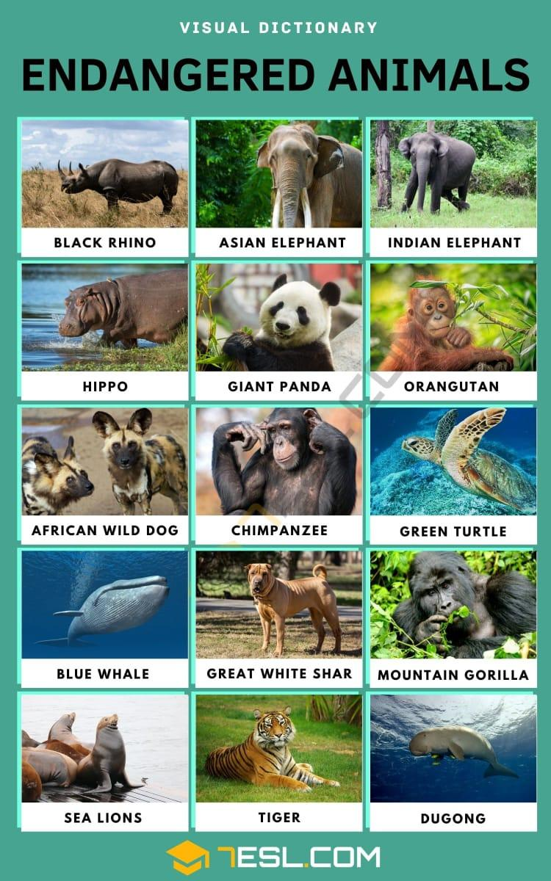
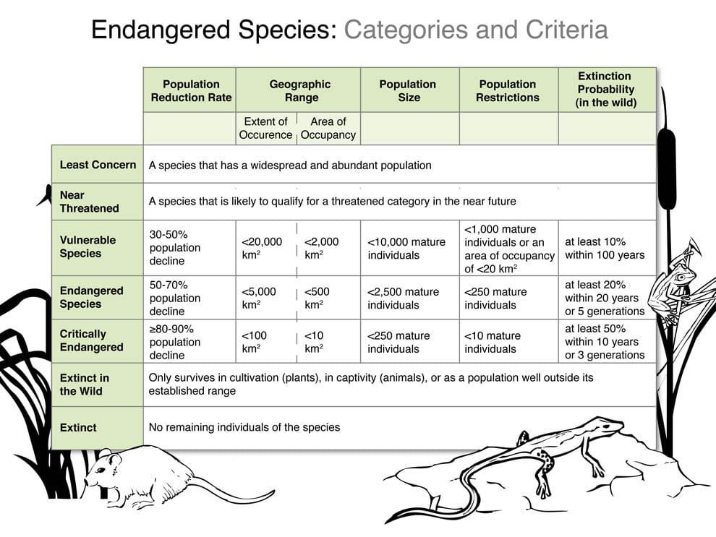
OIOR TABLE

Slide 16
Analysis
Identify Patterns
Evaluate Effectiveness
Prioritize Interventions
Successful Strategies
Protected Areas: Wildlife sanctuaries and marine reserves have shown positive impacts in stabilizing certain populations.
Technology Integration: AI, drones, and GPS tracking effectively monitor species and combat poaching.
Immediate Interventions
Strengthen Anti-Poaching Measures
Deploy technology like drones and motion sensors in critical habitats.
Train and equip wildlife rangers.
Local Communities
Identity Pattern: Depend on natural resources; often unaware of long-term environmental impact.
Motivation: Livelihood and survival.
Barrier: Limited access to alternative resources or education.

Slide 17
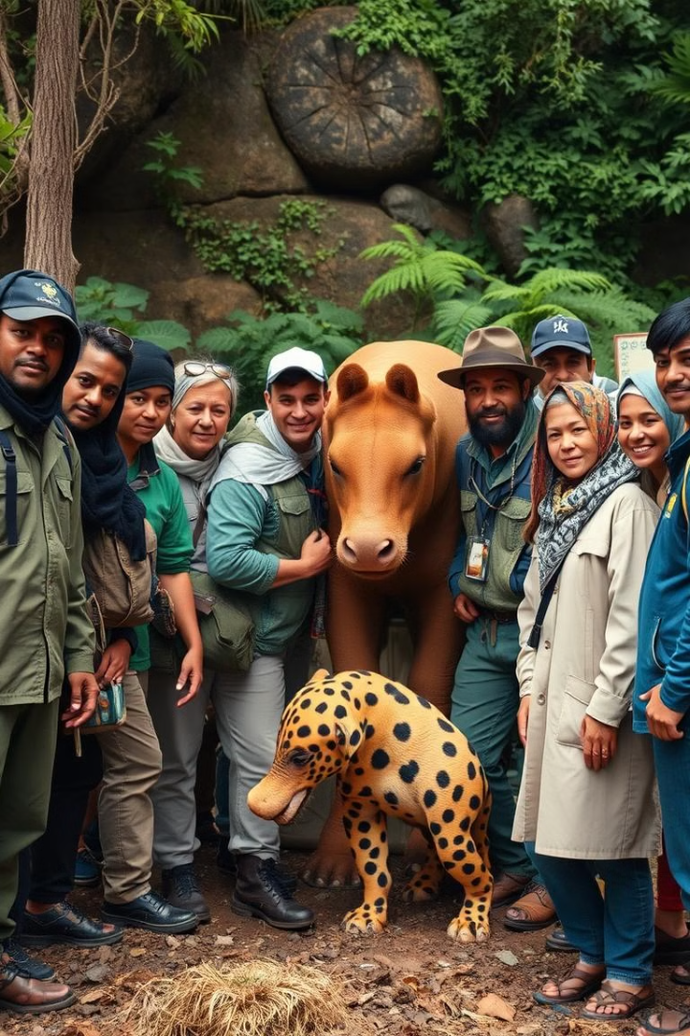



Conclusion and
Call to Action
Comprehensive Strategy
This strategy integrates immediate, medium, and long-term interventions, focusing on stakeholder collaboration, technology, and sustainable practices. The goal is to address the root causes of species endangerment while fostering a balance between conservation and human development.
Collaborative Approach
A collaborative approach involves uniting diverse stakeholders—governments, communities, businesses, NGOs, and the global public—toward a shared vision of biodiversity conservation. By pooling resources, expertise, and influence, this approach ensures sustainable and scalable outcomes.
Call to Action
The survival of endangered species depends on unified and immediate action. Every individual, community, organization, and government has a role to play in ensuring the protection and restoration of biodiversity.

Slide 18
PROTOTYPE

Slide 19
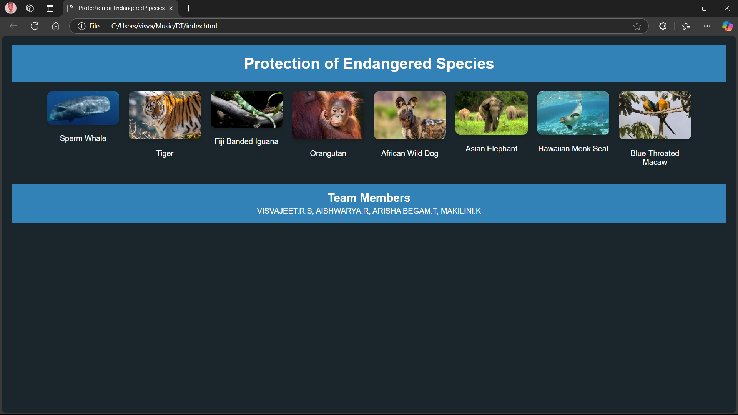

Slide 20
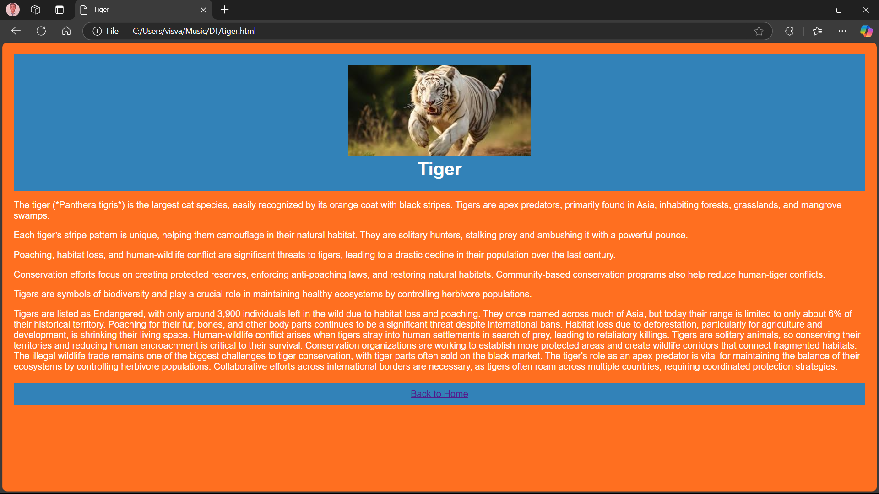

Slide 21
THANK
YOU

